Slide 1
pip* comparisons
Deep dive into pip, pipenv and poetry

Slide 2

Pip: Package Manager
Resolves, downloads , installs and uninstalls Python packages from Package indexes or arbitrary URLs
Utilizes requiremets.txt

Slide 3
Virtualenv
Creates isolated environments for packages to be installed in, one for each project.
Currently, there are two common tools for creating Python virtual environments:
venv is available by default in Python 3.3 and later
$ python3 –m venv <DIR>
virtualenv needs to be installed separately, but supports Python 2.7+ and Python 3.3+
$ virtualenv <DIR>
Notes:
A virtual environment is a Python environment such that the Python interpreter, libraries and scripts installed into it are isolated from those installed in other virtual environments, and (by default) any libraries installed in a “system” Python, i.e., one which is installed as part of your operating system.
Imagine you have an application that needs version 1.0.0 of Flask, but another application requires version 1.0.2. How can you use both these applications? If you install everything into /usr/lib/python3.6/site-packages (or whatever your platform’s standard location is), it’s easy to end up in a situation where you unintentionally upgrade an application that shouldn’t be upgraded.
Or more generally, what if you want to install an application and leave it be? If an application works, any change in its libraries or the versions of those libraries can break the application.
Also, what if you can’t install packages into the global site-packages directory? For instance, on a shared host.
In all these cases, virtual environments can help you. They have their own installation directories and they don’t share libraries with other virtual environments.
venv is available by default in Python 3.3 and later, and installs pip and setuptools into created virtual environments in Python 3.4 and later.
virtualenv needs to be installed separately, but supports Python 2.7+ and Python 3.3+, and pip, setuptools and wheel are always installed into created virtual environments by default (regardless of Python version).

Slide 4
requirements.txt
python3 –m venv venv
source venv/bin/activate
$ pip install flask
$ pip freeze > requirements.txt
Deterministic builds
Includes transitive dependencies
Difficult to differentiate between “What you want installed” vs “What you need installed”
click==7.0
flask==1.0.3
itsdangerous==1.1.0
jinja2==2.10.1
markupsafe==1.1.1
werkzeug==0.15.4
Notes:
All inclusive of transitive dependancies
But it is unclear, what does your team need ?
Do you want click ? Or do you want itsdangerous ?
Or just Flask.

Slide 5
requirements.txt
Non deterministic builds
What you want installed
Human readable
Flask
Notes:
Some teams just pip Flask, however it results in non determistic builds. If any of these transient dependancies are updated and has some breaking issues, then this pattern will break your builds.

Slide 6
Upgrading your requirements
Manual upgrade workflow
OR
Pip-tools
A set of tools to create your pinned dependencies up to date
pip-tools = pip-compile + pip-sync
Requirements from setup.py or requirements.in
requirements.in – list your packages
pip-compile --output-file requirements.txt requirements.in
requirements.txt – updated with all the dependancies by piptools

Slide 7
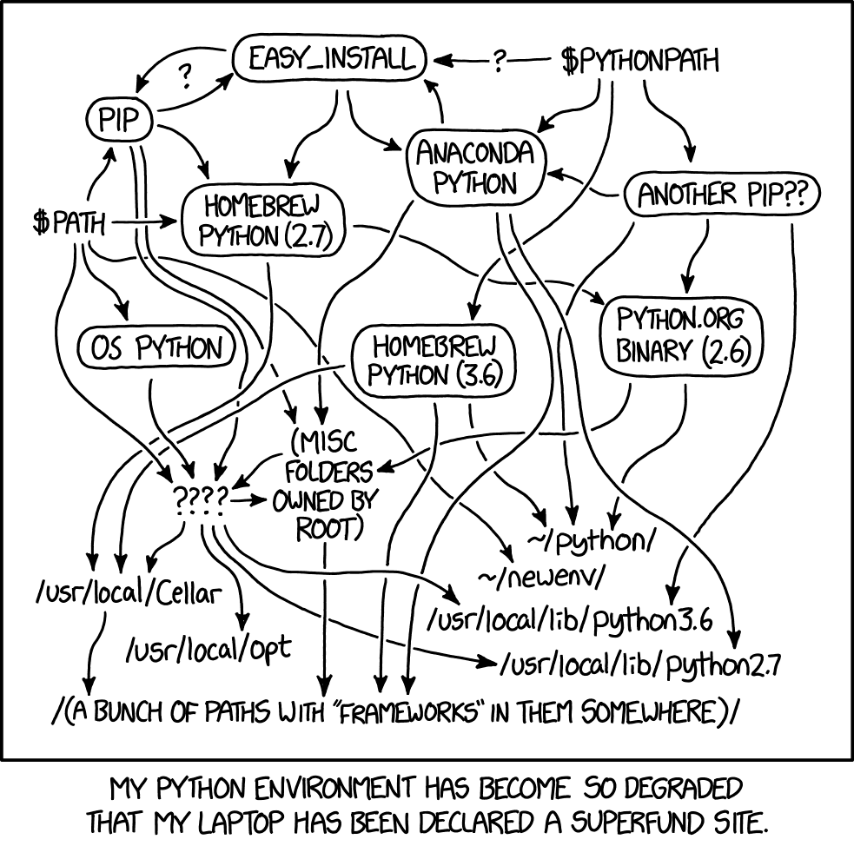
Many tools to manage environment

Slide 8
The (not so) new kid in the block - Pipenv
What is pipenv trying to solve ?
Pip + virtualenv
One tool to create and manage virtual environment
Pipfile
to list all your packages
Pipfile.lock
to list your high level and transient dependencies
Deterministic builds
No need to manually add requirements into a file
Takes care of transient dependency management
Notes:
You no longer need to use pip and virtualenv separately. They work together.
It automatically creates and manages a virtualenv for your projects, as well as adds/removes packages from your Pipfile as you install/uninstall packages. It also generates the ever-important Pipfile.lock, which is used to produce deterministic builds.

Slide 9
What pipenv does ?
Manages your upgrade workflow
Editable depedancies
Importing from requirements.txt
can configure a tox.ini for both local and external testing
Performs Security checks on installed packages
And other advance functionalities
PyCharm and Vscode automatically detects virtual environments created by Pipenv
Notes:
Find out what’s changed upstream: $ pipenv update --outdated.
Upgrade packages, two options – upgrade everything or one package at a time
You can tell Pipenv to install a path as editable — often this is useful for the current working directory when working on packages:
If you only have a requirements.txt file available when running pipenv install, pipenv will automatically import the contents of this file and create a Pipfile for you.
Pipenv will automatically use the virtualenv provided by tox. If pipenv install --dev installs e.g. pytest, then installed command pytest will be present in given virtualenv and can be called directly by pytest tests instead of pipenv run pytest tests. You might also want to add --ignore-pipfile to pipenv install, as to not accidentally modify the lock-file on each test run. A 3rd party plugin, tox-pipenv is also available to use Pipenv natively with tox.
Changing Default Python Versions

Slide 10
Main problems with Pipenv
The break-neck pace of pipenv
Pipenv does not handle any parts of packaging
It's not suited for libraries and is not designed to be.
The dependency resolution is erratic.
Locking performance, there are many issues about dependency resolution.
Notes:
A good packaging tool is stable. In other words, it doesn’t change often, and it strives to support existing environments.
(cannot produce sdists and wheels). Users who want to upload to PyPI need to manage a setup.py file manually, alongside and independently of Pipenv.
Pipenv only concerns itself with managing dependencies. It isn’t a packaging tool. If your project has a setup.py, you still need to manually manage install_requires.
Pipenv produces lockfiles, which are useful for reproducibility, at the cost of installation speed.
Pipenv tried to upgrade all the versions of everything in your lockfile whenever you add a new package
Pipenv later added a pipenv lock --keep-outdated option to request a minimal lockfile update rather than the default comprehensive one

Slide 11
Poetry – What about it ?
Poetry uses standardized pyproject.toml instead of customized Pipfile as the project deps configuration file.
Every project is a package
Efficient dependency resolver at the heart of Poetry.
Deterministic builds by using poetry.lock
Package and Publish your library or application to PyPI or a private repository
tox is supported as well
Notes:
Poetry is a tool for dependency management and packaging in Python, like Pipenv. It allows you to declare the libraries your project depends on and it will manage (install/update) them for you.
Its main aim is close to Pipenv, but it also makes it possible to distribute things to PyPI.
Poetry does a lot of work on deps resolution and packaging, so that pyproject.toml can replace setup.py, it is monolithic. While Pipenv is more like a wrapper built on top of pip and virtualenv(or pew).
As soon as you have a pyproject.toml in a directory, that directory is a package. However, to make it accessible to others you will need to package and publish it.
Before you can actually publish your library, you will need to package it – using poetry build.
Poetry will publish to PyPI by default. Anything that is published to PyPI is available automatically through Poetry. Since pendulum is on PyPI we can depend on it without having to specify any additional repositories.
. By using the isolated builds tox provides, you can use it in combination with the PEP 517 compliant build system provided by Poetry.

Slide 12
Caveats of Poetry
Poetry puts python requires in dependency section. Python requires should be placed in global settings, although it shares the same version specifiers with normal dependencies.
Like Pipenv , Poetry doesn’t support to activate a virtualenv outside of project directory.
Poetry only works under one workflow. For instance, it doesn't support installing current dependencies into system Python, which is the typical workflow for developing in docker.
Cannot pip install –e directory
Cannot import from an existing to a requirements.txt
Venv created by Poetry is not automatically recognized by vscode or PyCharm
Notes:
Can customize where to install a virtual environment using :
poetry config settings.virtualenvs.in-project true

Slide 13
Conclusions
Pip is here to stay and it is fast!
Can manage the upgrade workflow using pip-tools
The virtualenv management features can be provided by virtualenvwrapper.
Pipenv is no longer the officially recommend tool and it forces a particular worklow on its users
Poetry tries to solve many of Pipenv’s issues, however due to the all-encompassing file format , there is a vendor lock-in.
Notes:
Pip, setup.py, and virtualenv — the traditional, tried-and-true tools — are still available, undergoing constant development. Using them can lead to a simpler, better experience. Also of note, tools like virtualenvwrapper can manage virtualenvs better than the aforementioned new Python tools, because it is based on shell scripts (which can modify the enivironment).
Pipenv, contrary to popular belief and (now removed) propaganda, is not an officially recommended tool of Python.org. It merely has a tutorial written about it on packaging.python.org (page run by the PyPA).
Pipenv solves one use case reasonably well, but fails at many others, because it forces a particular workflow on its users.
Poetry supports the same niche Pipenv does, while also adding the ability to create packages and improving over many gripes of Pipenv. A notable issue is the use of a custom all-encompassing file format, which makes switching tools more difficult (vendor lock-in).

Slide 14
DEMO AND FAQ’S

